Slide 1
Project 5
Predicting Stock Price
By Alex Lu
Oct 2019

Slide 2
Problem
Predicting today’s stock price based on past 5 year dataset containing: fundamental data, Macro data and technical data.
As an example, we use apple stock in our modeling. We will predict apple stock’s closing price using different models: Deep learning method, Ensemble Machine Learning, arima, pca linear regression, prophet and dynamic linear regression.

Slide 3
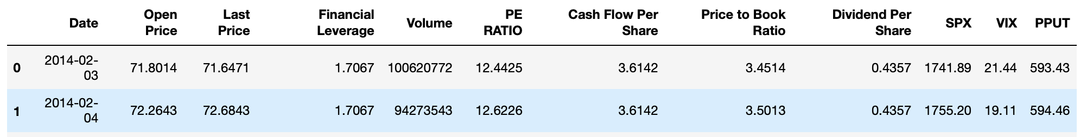
Data
Source: private source in combine with CBOE open source data (http://www.cboe.com)
Raw Data contains information on Apple stock. The variables can be described in 3 categories:
Technical data: Open Price, Last Price, Volume.
Fundamental data: Financial Leverage, PE RATIO, Cash Flow per Share, Price to Book Ratio, Dividend Per Share.
Macro data: SPX, VIX, PPUT. (Note: VIX - volatility index; PPUT - put option price for S&P; SPX - S&P price.)
Target: Last Price (or the closing price on apple stock); Variables: all other columns

Slide 4
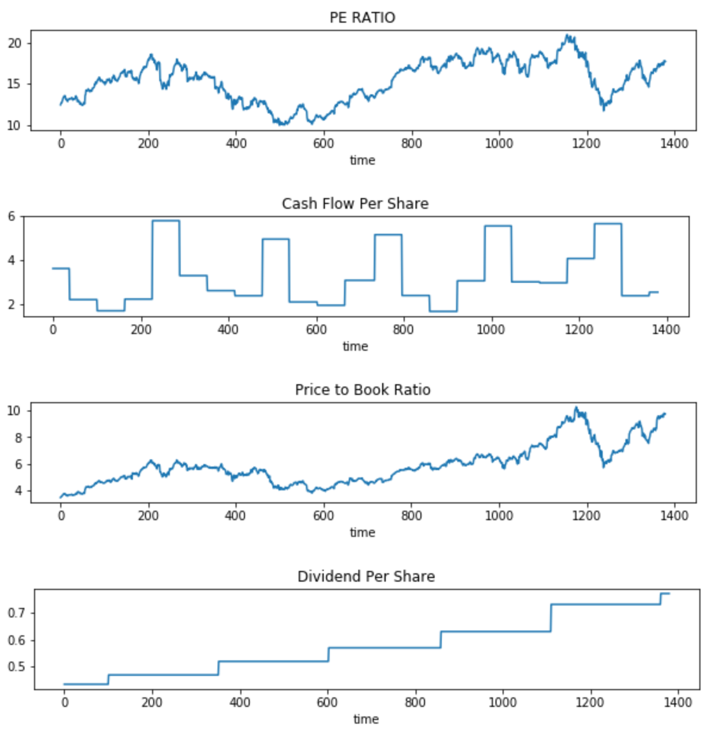
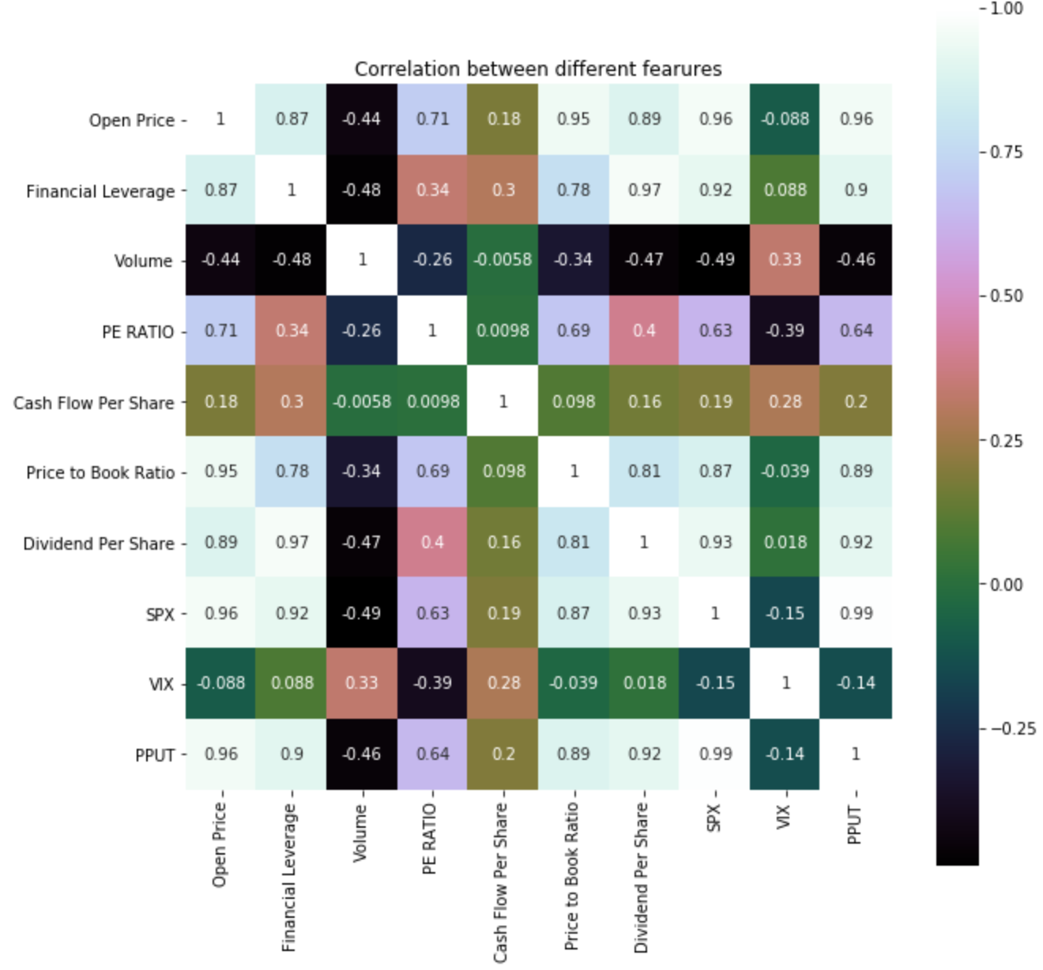
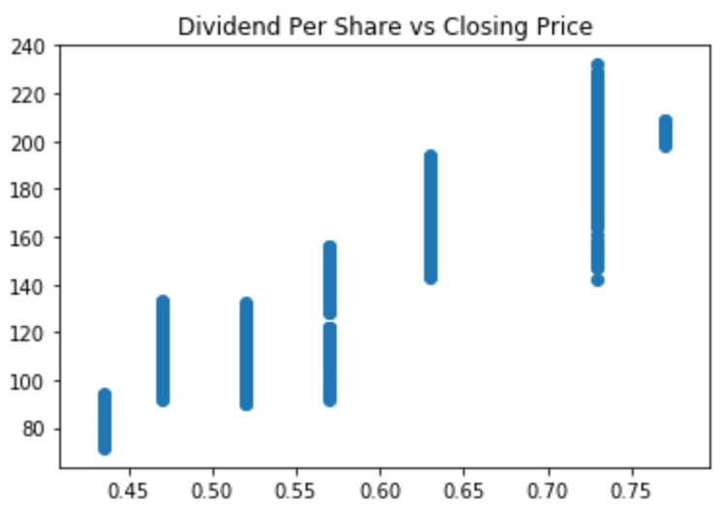
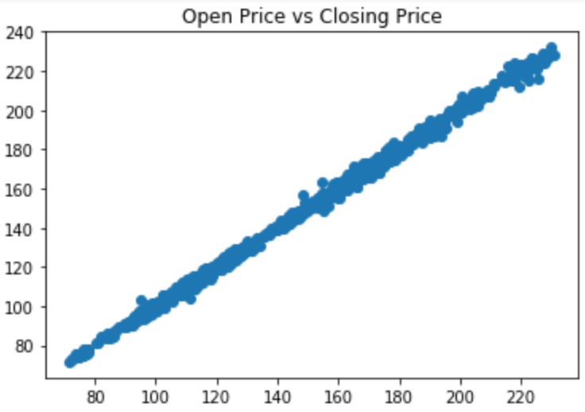
Examine Data
Individual graphs:
Clean data with no abnormality. As expected, fundamental data have a step function curve shape due to quarter reporting.
Correlation graph:
Some variables are highly correlated justifiable: SPX and PPUT. Both reflects macro sentiments.
Target (close price) vs variable graph:
There is a clear linear relationship between Open Price, SPX, PPUT and close price as expected. There is a trending stepwise form of linear relationship between fundamental data and target: this is because fundamental financial data is updated when earning announcement happens, every quarter. It is not clear if there is a relationship between target and volume, VIX.

Slide 5
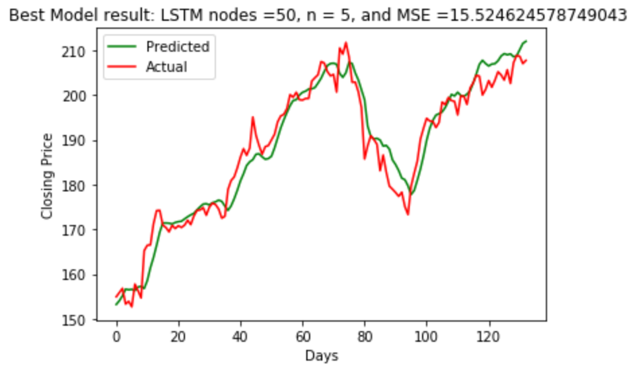
Solution: DL (MSE 15.5)
Intuition: taking in past number of days performance in the stock itself, incorporating its own fundamental data and macro trading sentiment to predict today’s closing price. In this project, we use 11 data points per day ('Open Price', 'Financial Leverage', 'Volume', 'PE RATIO', 'Cash Flow Per Share', 'Price to Book Ratio', 'Dividend Per Share', 'SPX', 'VIX', 'PPUT’, ‘Last Price’.)
Test with 3 different day lag 5, 10 and 20 on each of the two LSTM models (ie 3x2 = 6 combinations). (Note: Long Short Term Memory (LSTM) model: LSTM is type of RNN neutral network model that solves long time lag, and it is often used for time series problems like the one we are working on. )
The winning model is a one with 50 nodes, 5 days data lag. It produced a MSE result of 15.5. The model consists of 1 LSTM + dropout (0.5) + 1 dense layer + dropout(0.5) + 1 dense layer, linear activation

Slide 6
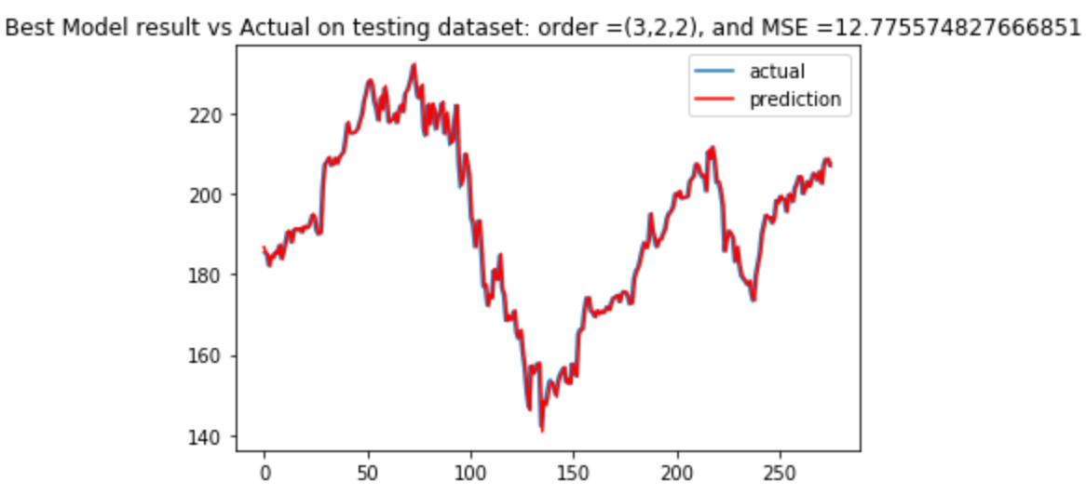
Solution: ARIMA (MSE 12.8)
Intuition: only use the stocks closing price as input dataset to see if previous days momentum is sufficient to predict today’s closing price. Y = (Auto-Regressive Parameters) + (Moving Average Parameters)
Test ARIMA model with different parameters:
p = the number of autoregressive terms d = the number of nonseasonal differences
q = the number of moving-average terms
The winning model is an ARIMA model with p=3, d=2, q=2 MSE=12.776

Slide 7
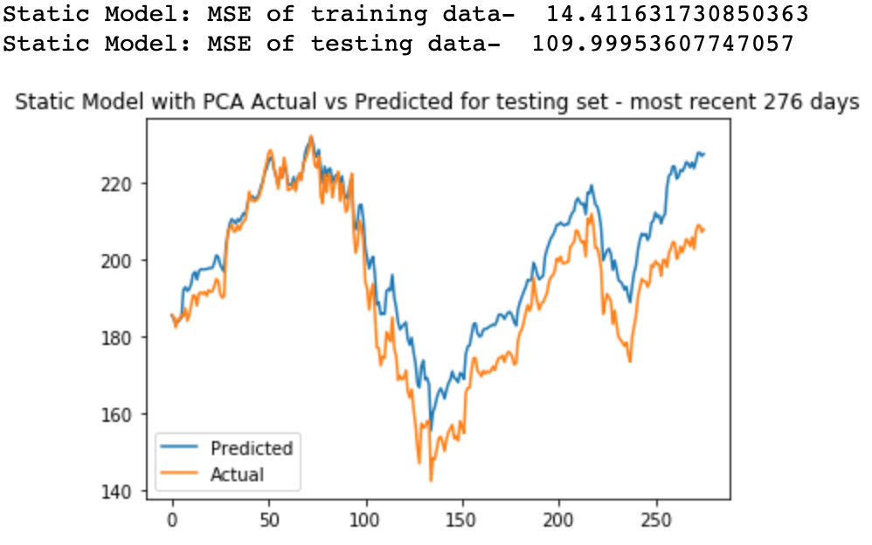
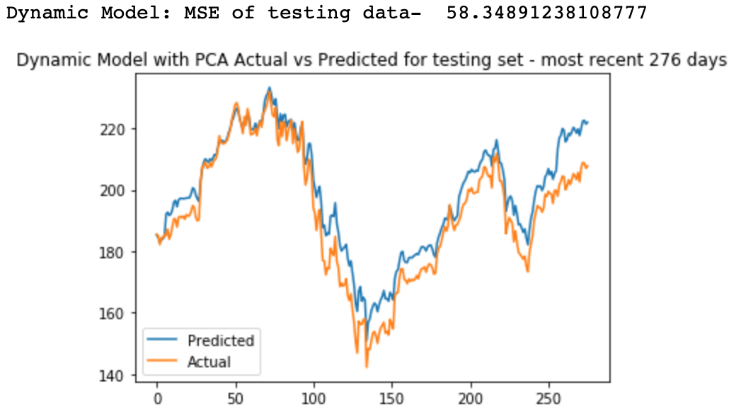
Solution: PCA + linear (MSE 58)
Intuition: reduce 10 variable problem into fewer PCA components then run linear regression
PCA decomposition suggests that 5 components can explain 97.8% of the variance. Next we run a linear regression model with 5 components.
Static linear regression model produced a testing MSE of 110, and training set MSE of 14.
Is this because we have ’overfitted’ training model or do we need a dynamic model?
Dynamic linear regression model produced a testing MSE of 58.

Slide 8
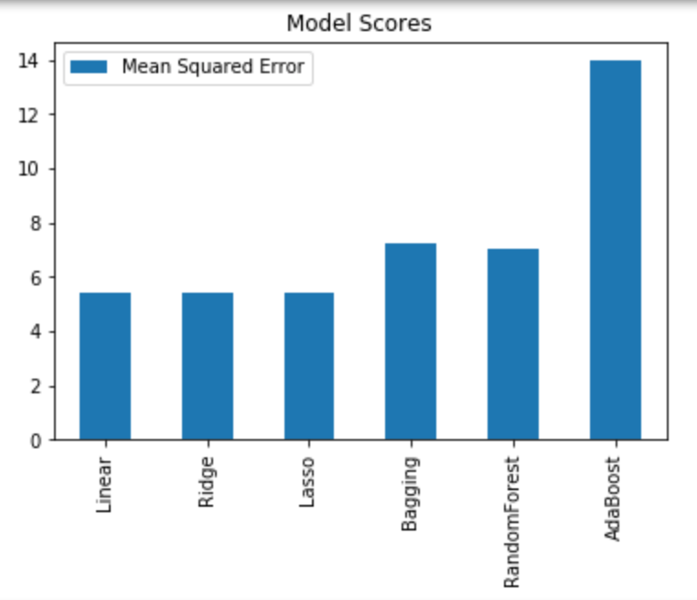
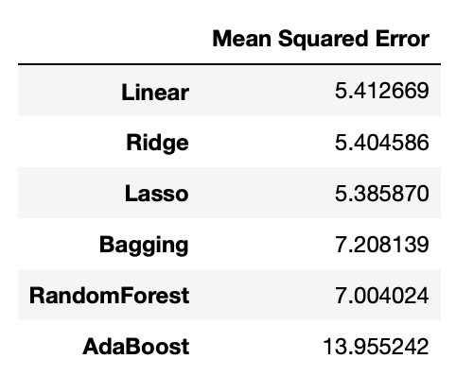
Solution: Dynamic model for linear regression, Ridge, Lasso, Bagging, RandomForest, Adaboost (MSE=5.4)
Intuition: having seen dynamic model works better, we will try 6 different models on dynamically adjusted training set and select the best MSE.
The result shows that dynamic Lasso model works the best, albeit the next 2 best models (Linear and Ridge) have a very similar MSE.

Slide 9
Conclusion
A Lasso Linear regression model produced the best result with dynamically increasing training data set with MSE of 5.4.
Business implication:
A MSE of 5.4 implies about 1% variability from actual data. This is a pretty good guidance, however, might not be granular enough for day trading given daily movement is often sub 1%.
The model needs to be refined further, and here are what could be done next:
For Linear Regression: Introducing comparable stocks into the dataset (ie FANG group: Google/Facebook/Amazon). This will allow fundamental data to play a bigger role in deciding stock valuation.
Tuning parameters in Lasso/Linear/Ridge.
Change target and input variable from absolute price to first derivative ‘change on the day’. Re-run all the models. This potentially could give better granularity to the prediction.

Slide 10
THE END
THANK YOU FOR LISTENING!

